Slide 1
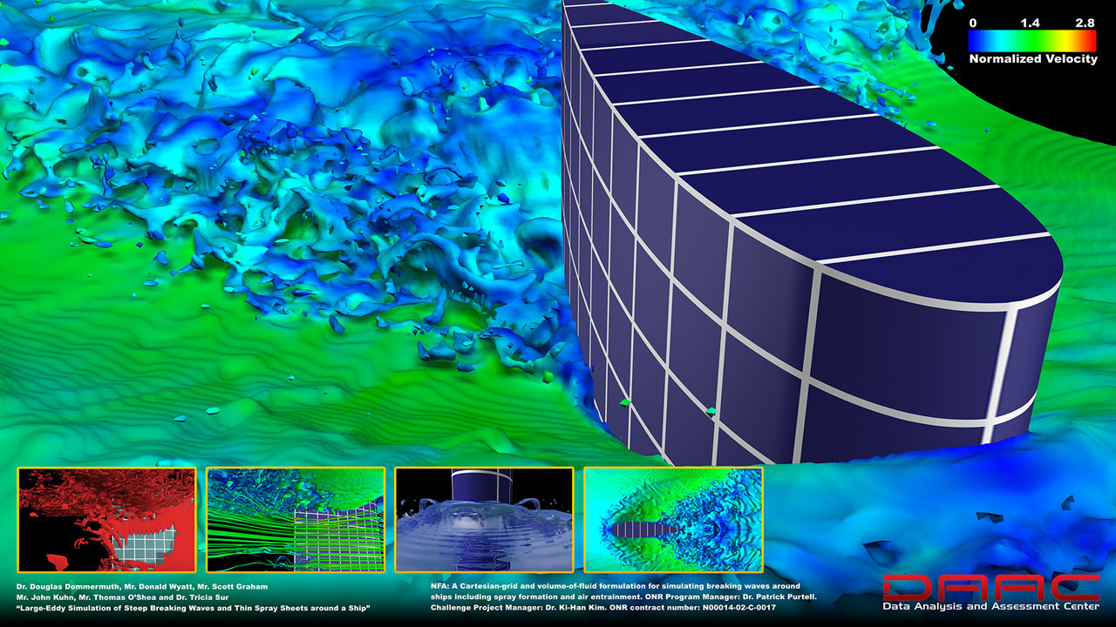
PHYS 8750 Numerical Fluid Dynamics
Fall, 2020
daac.hpc.mil/gallery/

Slide 2
PHYS 8750
Outline
Summary
Temporal schemes for ODEs (Chapter 2)
Temporal filtering for ODEs (Chapter 2)
Spatial schemes for PDEs (Chapter 3)
Spatial filtering for PDEs (Chapter 3)
Staggered grids for 2 variables (Chapter 4)
Schemes (CTU) for 2 dependents (Chapter 4)
Class #13 (Chapter 4.2)
1) PDE with two variables
2) Lax-Wendroff + CTU
Class #14
Summary of Chapters 1-4

Slide 3
Summary of Chapter 1-4
Purpose:
Solve the systems/problems described by PDEs numerically (analytical form is too different to obtain)
Finite-Difference Scheme:
Use discretized form (grids) to approximate partial derivatives/ use discontinuous grids to represent continuous PDE.
Criteria to judge a scheme:
1. Order of accuracy, convergence, stability (solutions are constrained)
2. Amplitude and phase errors damping/dissipation and dispersion
Key Issue: How to improve 1, and avoid 2.

Slide 4
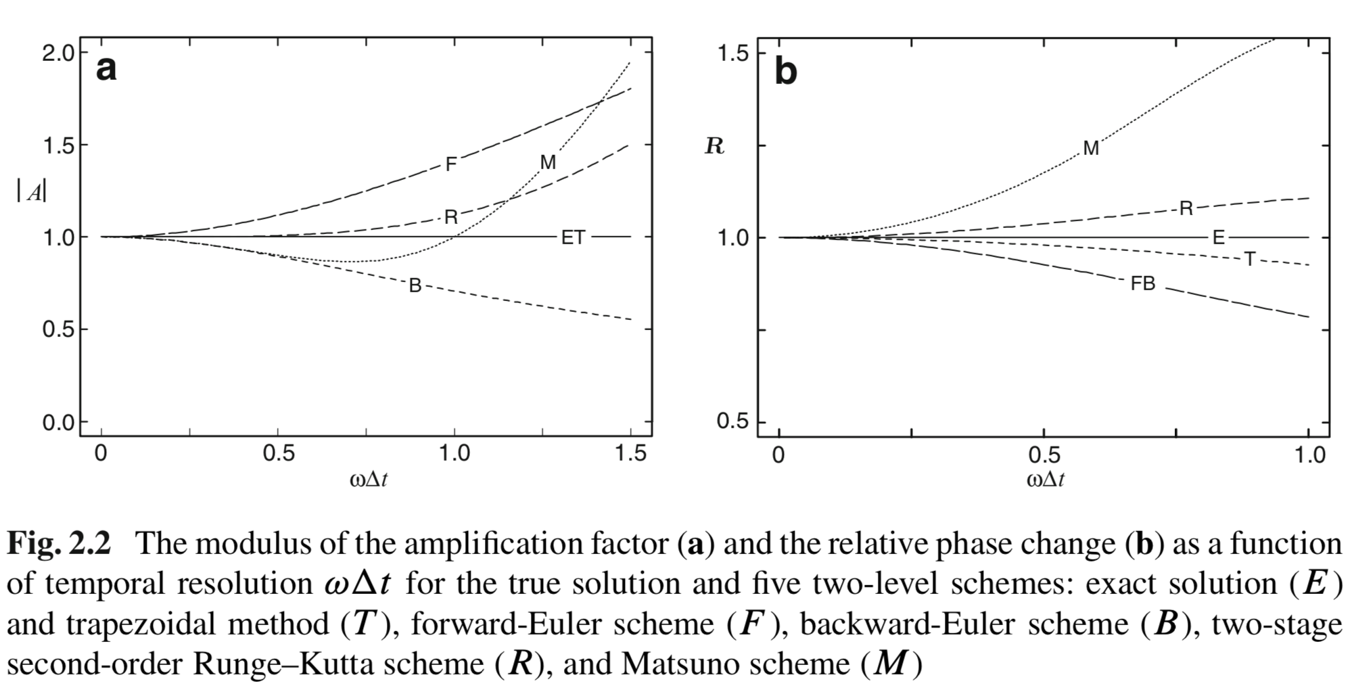
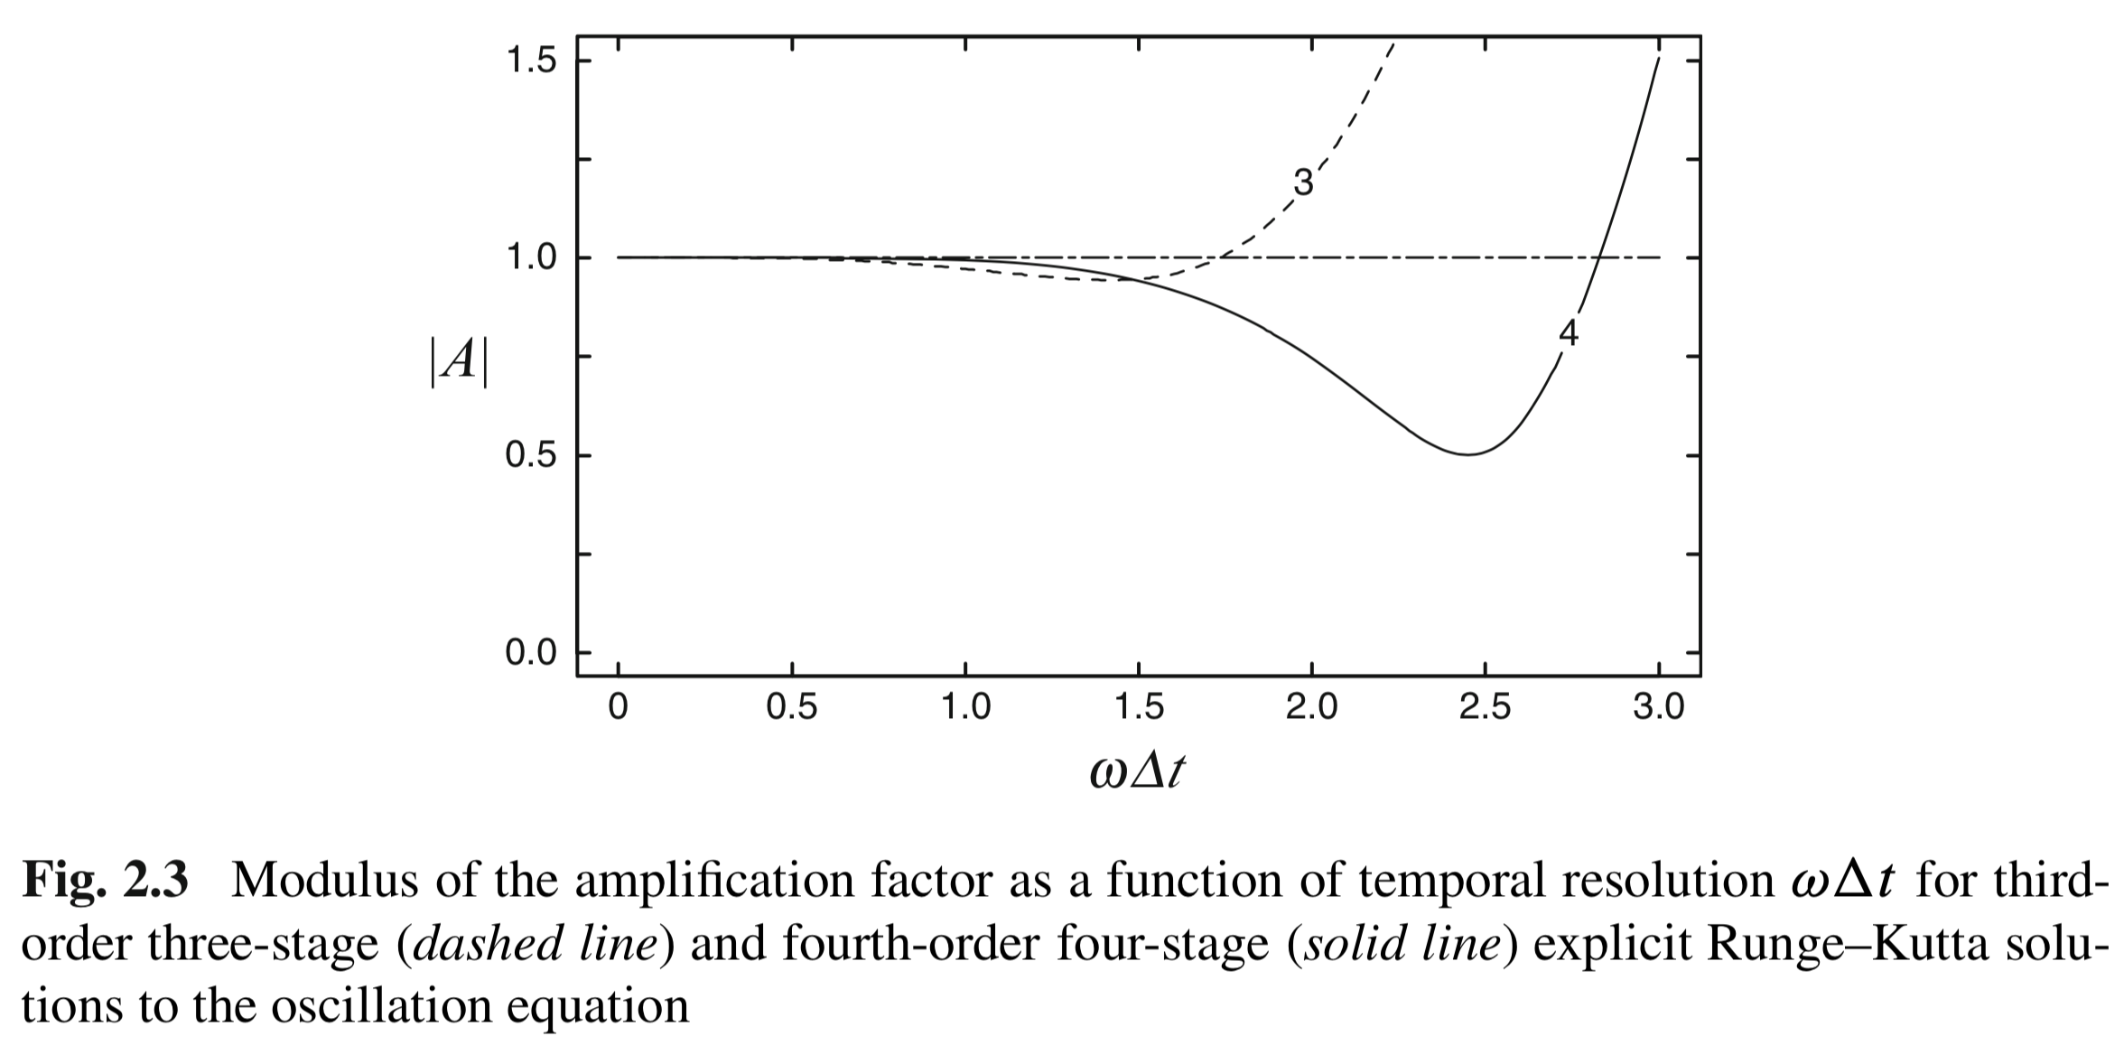
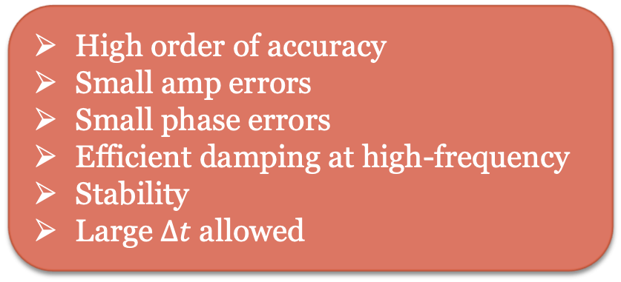
Amplitude and Phase Behavior
E: exact solution T: trapezoidal F: Forward B: Backward R/3/4: 2/3/4-stage Runge-Kunta M: Matsuno
Multi-Stage Advantages
Disadvantages
High order of accuracy
Small amp errors
Small phase errors
Efficient damping at high-frequency
Stability
Large $Δt$ allowed
Evaluating derivatives multiple times
Extensive storage
More expensive computation

Slide 5
Multi-Step Scheme
Multiple time steps are used to computer the next time step.
Achieve high (usually second) order of accuracy, without using too much storage.
Physical and computational modes both exist. Need to suppress the errors arising from computation modes usually by temporal filtering.
Leapfrog & Adams-Bashforth

Slide 6
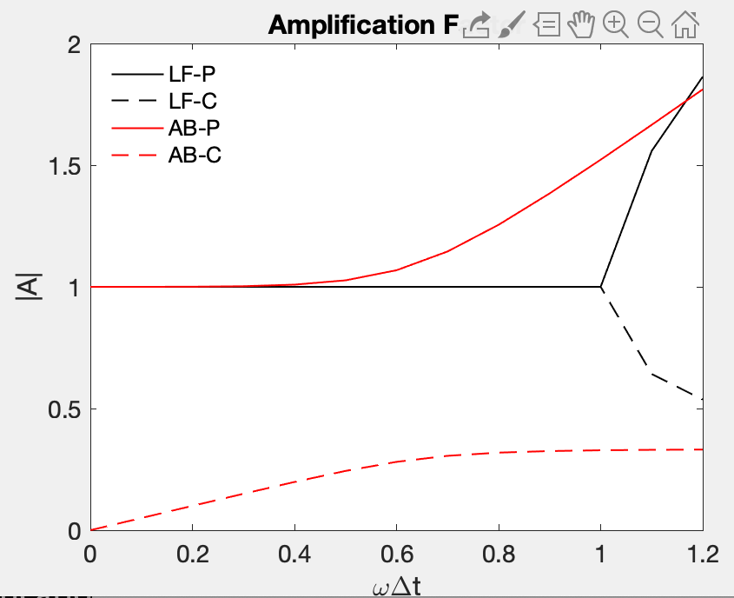
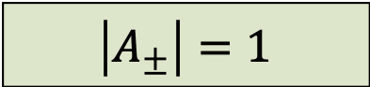
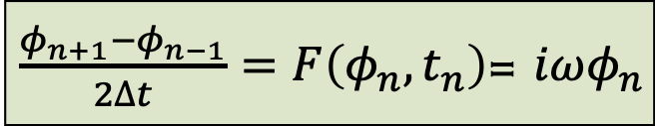
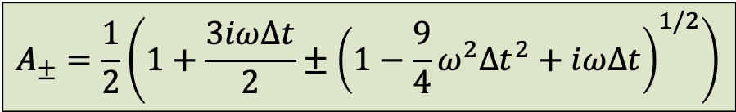
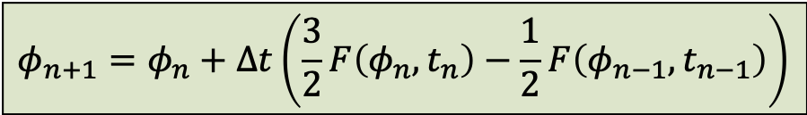
Multi-Step Scheme
Leapfrog
$\frac{φ_{n+1}−φ_{n−1}}{2∆t}=F\left(φ_{n},t_{n}\right)$= $iωφ_{n}$
$$\left|A_{±}\right|=1$$
Since amplification factors for both physical and computational modes are 1, use temporal filtering to suppress computational models
Adams-Bashforth
$$φ_{n+1}=φ_{n}+∆t\left(\frac{3}{2}F\left(φ_{n},t_{n}\right)−\frac{1}{2}F\left(φ_{n−1},t_{n−1}\right)\right)$$
$$A_{±}=\frac{1}{2}\left(1+\frac{3iω∆t}{2}±{\left(1−\frac{9}{4}ω^{2}{∆t}^{2}+iω∆t\right)}^{1/2}\right)$$
Filtering is inherently built in scheme

Slide 7
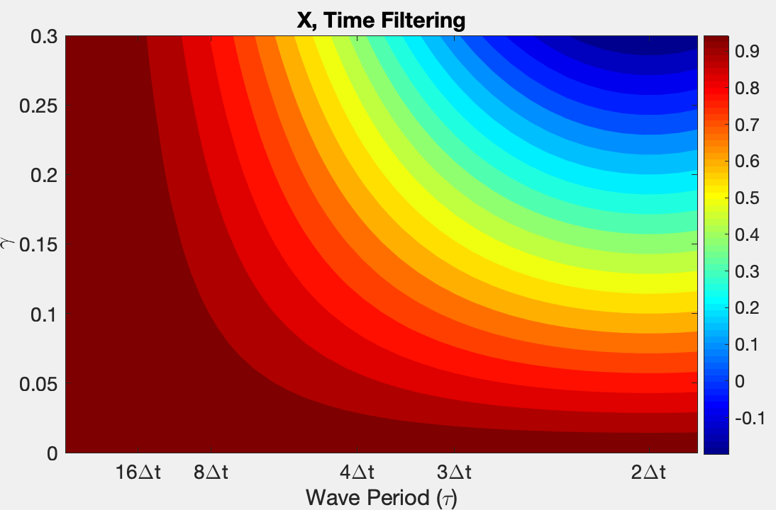
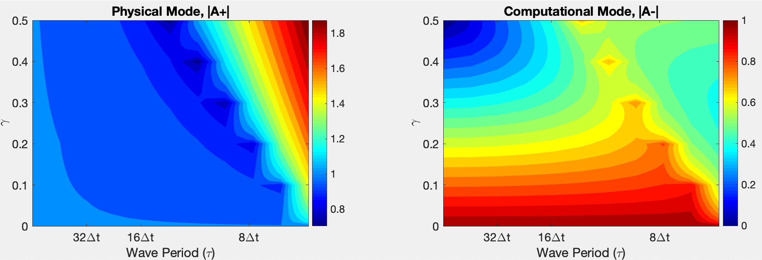
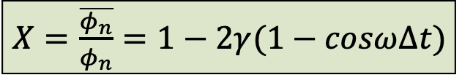
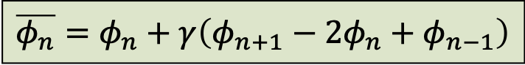
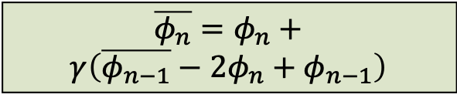
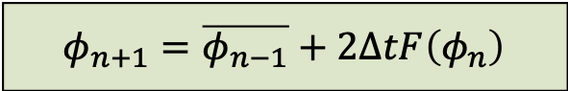
Temporal Filtering
1. Postprocessing Way:
$$\overline{φ_{n}}=φ_{n}+γ\left(φ_{n+1}−2φ_{n}+φ_{n−1}\right)$$
$X=$ $\frac{\overline{φ_{n}}}{φ_{n}}=1−2γ(1−cosω∆t)$
2. Interactive Way: Asselin-filtered
$$φ_{n+1}=\overline{φ_{n−1}}+2∆tF\left(φ_{n}\right)$$
$$\overline{φ_{n}}=φ_{n}+$$
$$γ\left(\overline{φ_{n−1}}−2φ_{n}+φ_{n−1}\right)$$

Slide 8
Oscillation Problem
Leapfrog w/wo filter, and Adams-Bashforth
Code: LF_AB_StabilityAmplification_ODE_OscillationProb_7.m
LF: would suffer computational mode
Asselin-LF: damp computational mode, accurate amplitude.
AB: damp computational mode, errors contaminate

Slide 9
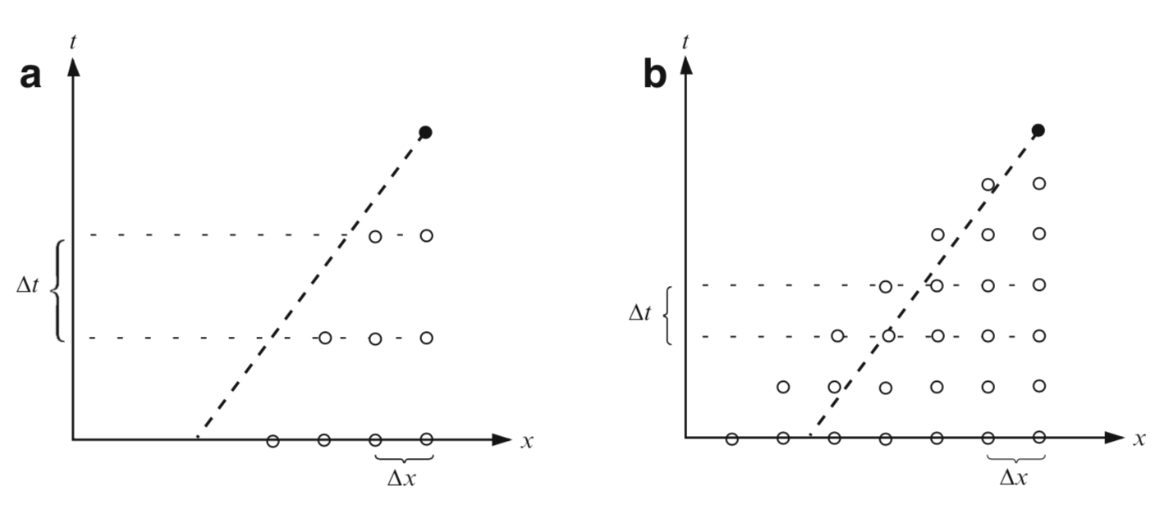
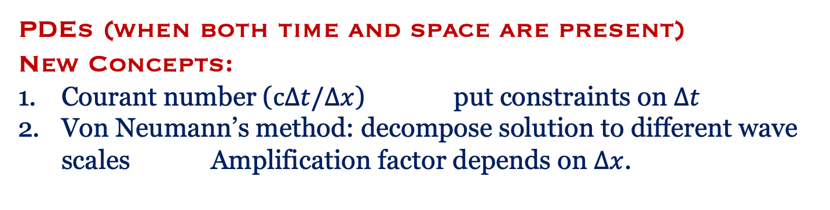
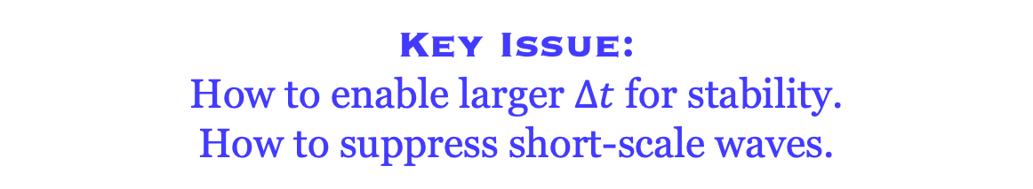
Chapter 3
PDEs (when both time and space are present)
New Concepts:
Courant number ($c∆t/∆x$) put constraints on $∆t$
Von Neumann’s method: decompose solution to different wave scales Amplification factor depends on $∆x$.
Key Issue:
How to enable larger $∆t$ for stability.
How to suppress short-scale waves.
CFL condition: Domain 1 includes Domain 2.
Strategies:
Higher-order of schemes by involving more spatial points.
Apply spatial filtering.

Slide 10
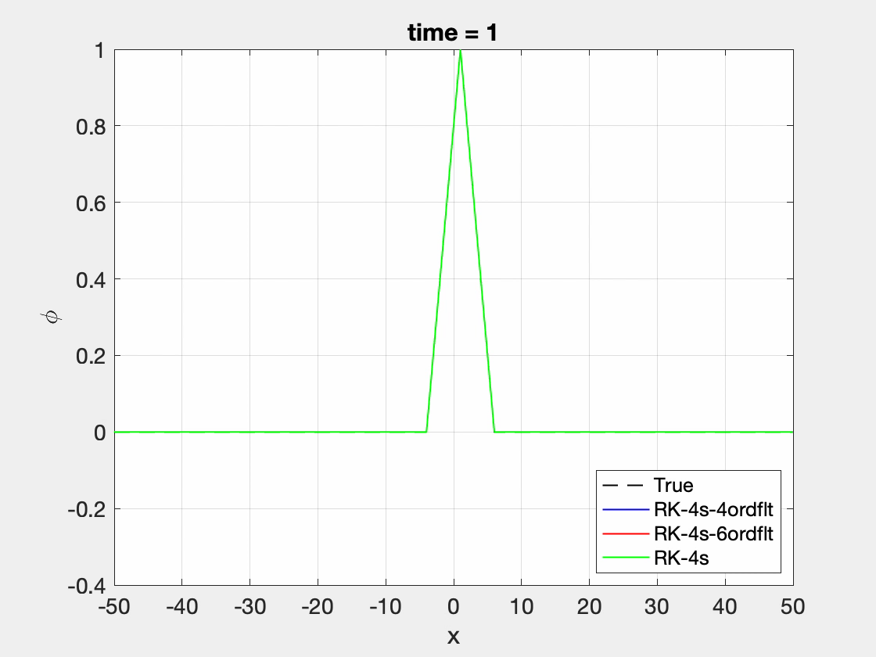
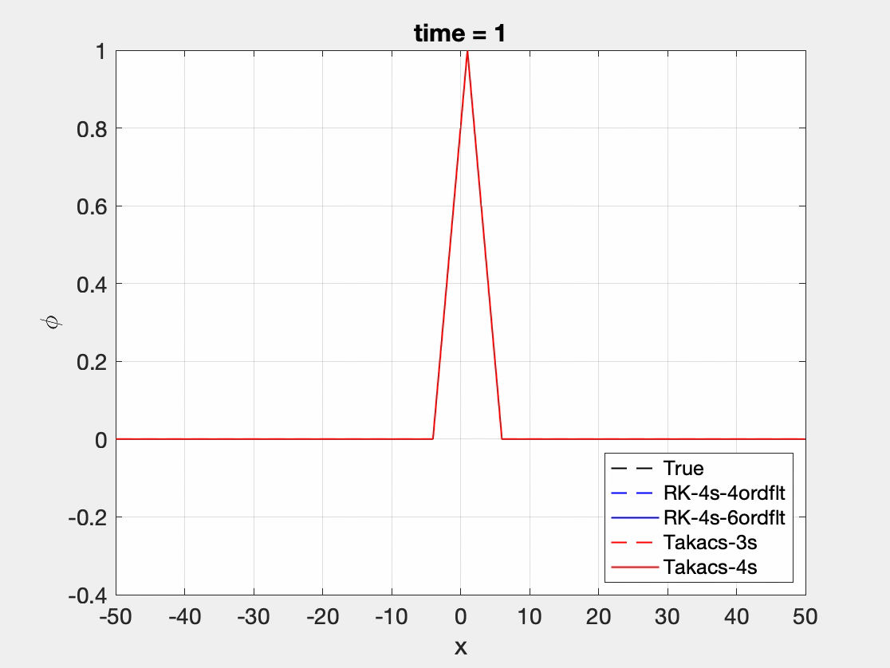
Takacs’s Schemes (Lax-Wendroff)
Higher-order of schemes by involving more spatial points.

Slide 11
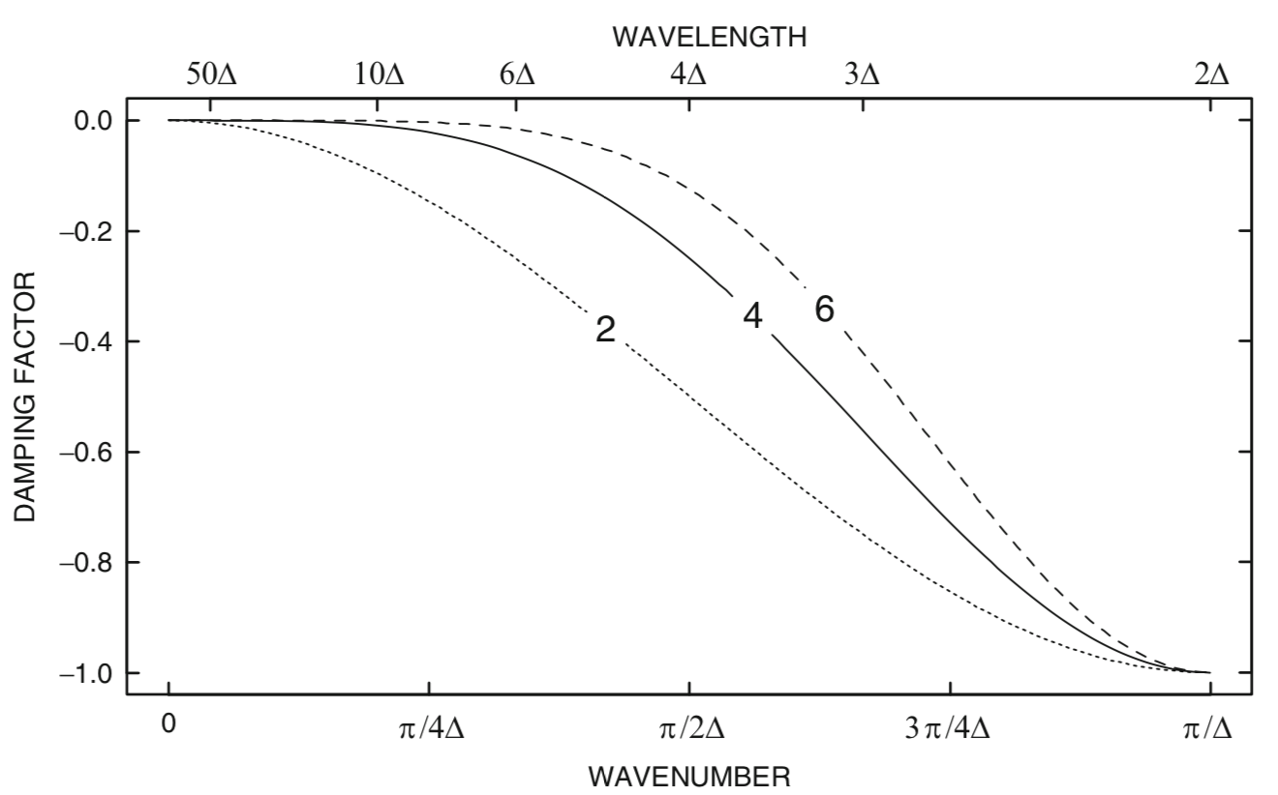
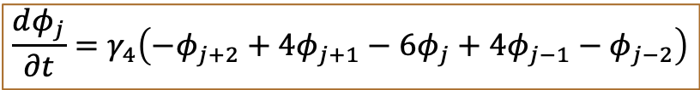
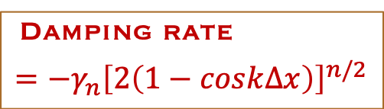
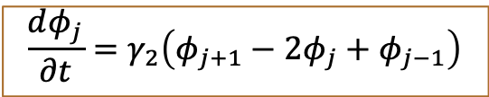
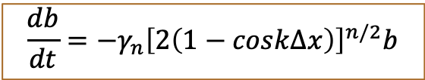
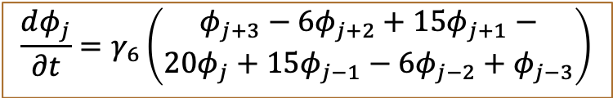
Spatial Filtering
Second-derivative smoother
$$\frac{dφ_{j}}{∂t}=γ_{2}\left(φ_{j+1}−2φ_{j}+φ_{j−1}\right)$$
4th-derivative smoother
$$\frac{dφ_{j}}{∂t}=γ_{4}\left(−φ_{j+2}+4φ_{j+1}−6φ_{j}+4φ_{j−1}−φ_{j−2}\right)$$
6th-derivative smoother
Damping rate
$$=−γ_{n}{\left[2\left(1−cosk∆x\right)\right]}^{n/2}$$
$$\frac{dφ_{j}}{∂t}=γ_{6}\left(\begin{aligned}φ_{j+3}−6φ_{j+2}+15φ_{j+1}− \\ 20φ_{j}+15φ_{j−1}−6φ_{j−2}+φ_{j−3}\end{aligned}\right)$$
Pros and Cons from low to high orders?
damping factor n^{th}-derivative smoother
$$\frac{db}{dt}=−γ_{n}{\left[2\left(1−cosk∆x\right)\right]}^{n/2}b$$

Slide 12
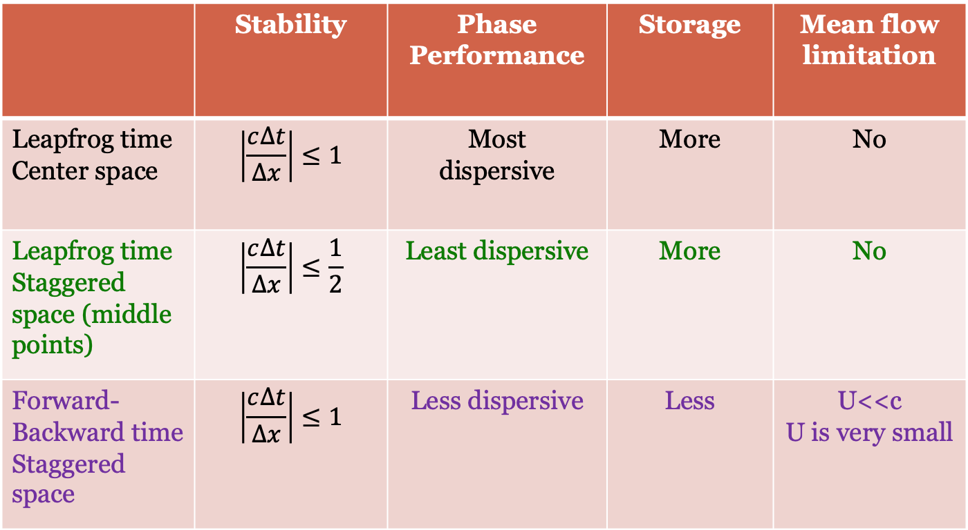
Multiple Dependent Variables/Staggered Grids
 | Stability | Phase Performance | Storage | Mean flow limitation
Leapfrog time Center space | $$\left|\frac{c∆t}{∆x}\right|≤1$$ | Most dispersive | More | No
Leapfrog time Staggered space (middle points) | $$\left|\frac{c∆t}{∆x}\right|≤\frac{1}{2}$$ | Least dispersive | More | No
Forward-Backward time Staggered space | $$\left|\frac{c∆t}{∆x}\right|≤1$$ | Less dispersive | Less | U<<c U is very small

Slide 13
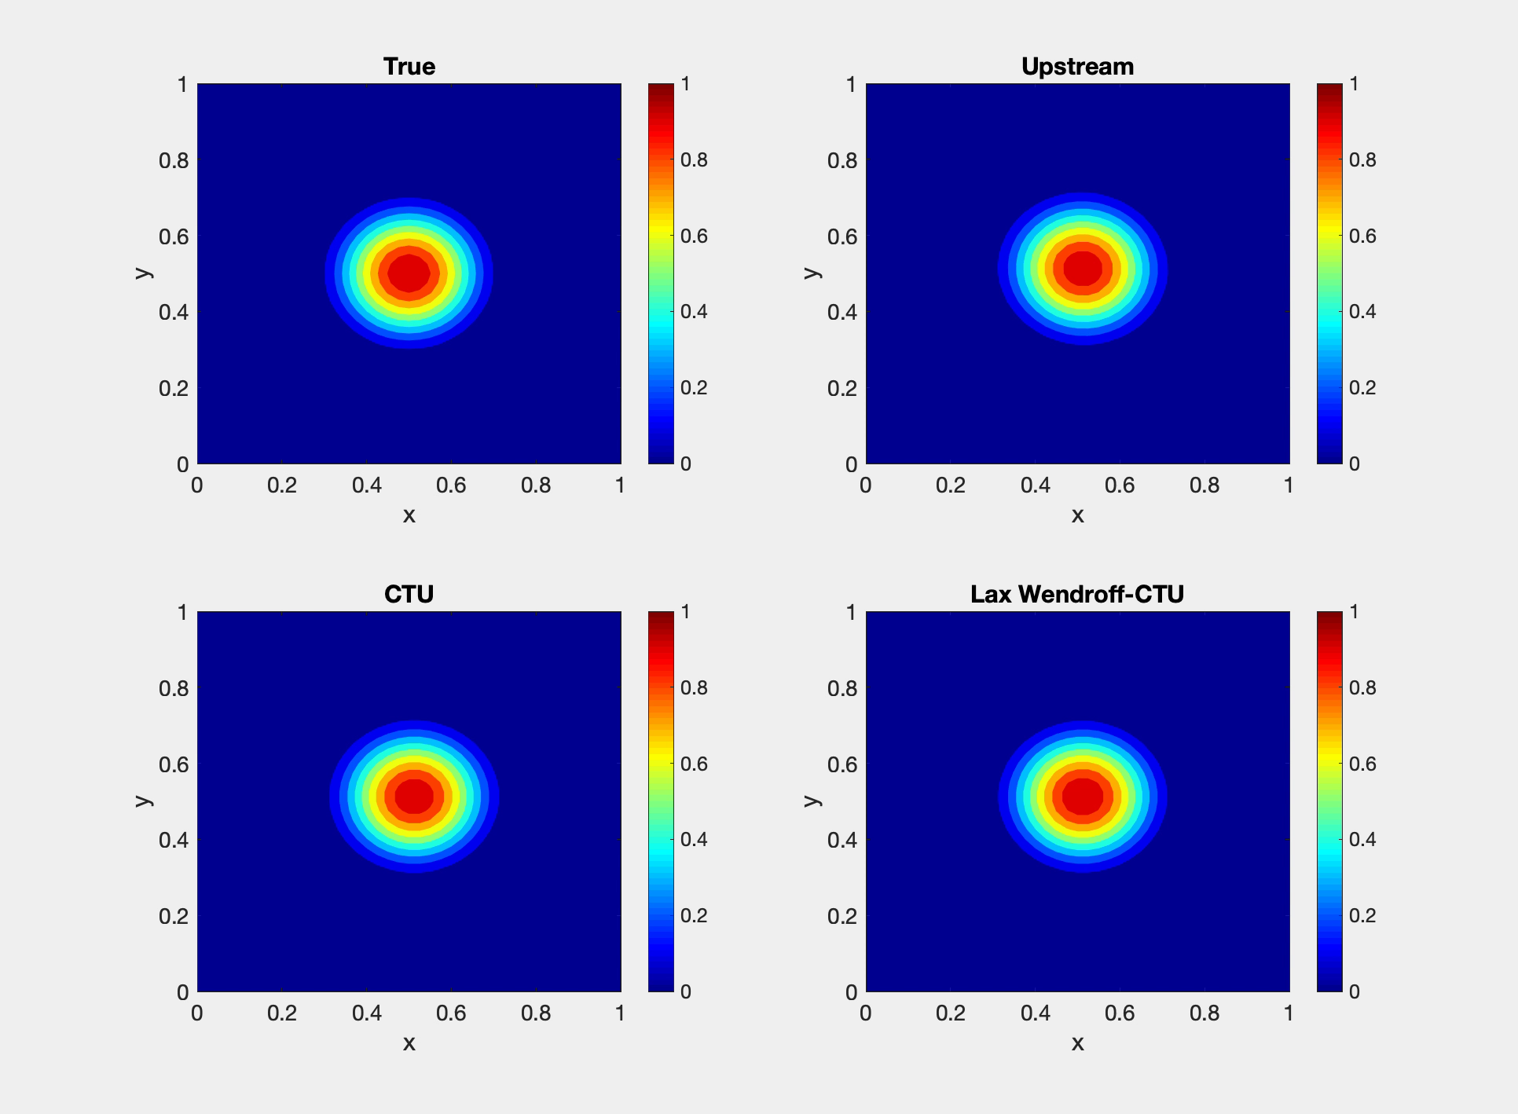
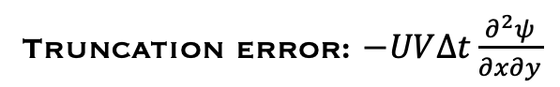
Multiple Dimensions (2D)
Truncation error: $−UV∆t\frac{∂^{2}ψ}{∂x∂y}$

Slide 14
Summary
Temporal schemes for ODEs (Chapter 2)
2-time levels: Forward, backward, trapezoidal
2-time levels & multi-stage: Runge-Kunta, Mastuno
Multi-time levels: Leapfrog (centered), Adams-Bashforth
Temporal filtering for ODEs (Chapter 2)
Applied to multi-time levels: suppress computational modes
Spatial schemes for PDEs (Chapter 3)
Upstream downstream, centered,
Lax-Wendroff, Takacs (forward time, control order of accuracy by involving more spatial points)
Spatial filtering for PDEs (Chapter 3)
2-nd derivative to N–th derivative filters
suppress
small scales

